Slide 1
The Evolution and Impact of Business Analysis
Notes:
This presentation was automatically generated by PowerPoint Copilot based on content found in this document: https://1drv.ms/w/c/1c3ede0d57884f42/EaIqz3HPDN1JoUg6k4lU5JIBOxJlye-6ix_jHS4t7MTkNg?e=RBJfIH AI-generated content may be incorrect.

Slide 2
Agenda
Introduction to Business Analysis
Origins and Development of Business Analysis
Successful Business Change
Scope of Business Analysis Work
Realising Business Benefits
Agile Systems Development
Supporting Business Change
Role and Responsibilities of a Business Analyst
Business Analysis Maturity Model
Professionalism in Business Analysis
Notes:
Agenda * Introduction to Business Analysis * Importance and Benefits * Challenges in Business Analysis * Definition and Scope * Origins and Development of Business Analysis * Historical Context * Impact of Outsourcing * Competitive Advantage through IT * Successful Business Change * Business Change Lifecycle * Role of Business Analysts in Change * Internal vs External Consultants * Scope of Business Analysis Work * Defining the Role * Range of Analysis Activities * Strategic Analysis and Definition * IT Systems Analysis * Business Analysis * Realising Business Benefits * Business Case Development * Holistic Approach * Agile Systems Development * Agile Philosophy * Role of Business Analysts in Agile * Implementation Challenges * Role and Responsibilities of a Business Analyst * Core Responsibilities * Extended Responsibilities * Rationale for Business Analysis * Business Analysis Maturity Model * Development and Maturity * Comparison with CMMI * Professionalism in Business Analysis * Qualifications and Standards * Future of Business Analysis

Slide 3
Importance and Benefits
Evolution of Business Analysis
Developed over the last two decades
Potential to offer great benefits to organizations
Alignment between Business Needs and Change Solutions
Involves new or enhanced information systems
Broader scope including business processes and job roles
Purpose of the Book
Provide guidance about business analysis
Reflects the breadth of the role and range of techniques
Role of Business Analysts
Skills and Value Addition
Recognition and Misconceptions
Notes:
Business analysis has evolved over the last two decades, offering significant benefits by aligning business needs with change solutions. This book aims to provide comprehensive guidance on the role and techniques of business analysts, addressing common misconceptions and highlighting their value to organizations. Original Content: INTRODUCTION This is a book about Business Analysis, a discipline that has evolved over the last two decades and has the potential to offer great benefit to organisations by ensuring that there is alignment between business needs and business change solutions. Many solutions involve the development of new or enhanced information systems but this is unlikely to be the extent of the business change, and it is probable that solutions will have a broader scope incorporating changes to areas such as business processes and job roles. The reason for producing this book is to provide guidance about business analysis that reflects the breadth of the role and the range of techniques used. While many organisations employ business analysts, there persists a lack of clarity about what the role really involves and this often creates more questions than answers. What do business analysts do? What skills do they require? How do they add value to organisations? Recognition in the broader business community is also an issue with many misconceptions regarding business analysis and a lack of appreciation of the contribution business analysts might make. Also, in the absence of a standard definition of business analysis and a standard set of business analysis activities, problems have arisen:

Slide 4

Challenges in Business Analysis
Introduction of Business Analysis in Organisations
Ensuring business needs are paramount when new IT systems are introduced
Difficulty in achieving this in practice
Documentation of Requirements
Lack of clear understanding of desired business outcomes
Background of Business Analysts
Experienced IT systems analysts less comfortable with business requirements
Business analysts with limited IT understanding
Communication Difficulties
Problems when IT forms part of the business solution
Insufficient understanding of IT causing communication issues with developers
Advice from Experienced Business Analysts
Notes:
Organisations have introduced business analysis to prioritize business needs when new IT systems are implemented. However, achieving this is challenging. Business analysts often document requirements without understanding desired outcomes. IT systems analysts may struggle with business requirements, while those with a business background may lack IT knowledge, causing communication issues. Experienced analysts' advice is often ignored due to a focus on governance. Original Content: Organisations have introduced business analysis to make sure that business needs are paramount when new IT systems are introduced. However, recognising the importance of this in principle is easier than ensuring that it is achieved. Many business analysts still report a drive towards documenting requirements without a clear understanding of the desired business outcomes. Some business analysts were previously experienced IT systems analysts and proved less comfortable considering the business requirements and the range of potential solutions that would meet the requirements. Many business analysts have a business background and have a limited understanding of IT and how software is developed. While knowledge of the business is invaluable for business analysts, problems can occur where IT forms part of the business solution and the analyst has insufficient understanding of IT. This may cause communication difficulties with the developers and could result in failure to ensure that there is an integrated view of the business and IT system. Some business analysts, as they have gained in experience and knowledge, have felt that they could offer beneficial advice to their organisations but a lack of understanding of the role, and a focus on ensuring governance rather than understanding the need, has caused organisations to reject or ignore this advice

Slide 5
Definition and Scope

Slide 6
Historical Context
Evolution of IT in Business
Improved business operations and management decision-making
Shift from IT departments to new services and products
Exploiting Business Opportunities
Enhancing portfolio of products and services
Organizational changes needed for benefits realization
Flexible Communication Mechanisms
Reaching out to customers
Connecting systems with suppliers
Supporting global operations
Focus on Core Processes
Dissatisfaction with IT Support
Notes:
IT developments have revolutionized business operations and decision-making. The focus has shifted from IT departments to new services and products. Flexible communication mechanisms help organizations reach customers and connect with suppliers. Despite the potential, dissatisfaction with IT support remains due to budget overruns and poor communication. Original Content: Developments in IT have enabled organisations to create information systems that have improved business operations and management decision-making. In the past, this has been the focus of IT departments. However, as business operations have changed, the emphasis has moved on to the development of new services and products. The questions we need to ask now are – ‘What can IT do to exploit business opportunities and enhance the portfolio of products and services?’ and ‘What needs to change in the organisation if the benefits from a new or enhanced IT system are to be realised?’ Technology has enabled new business models to be implemented through more flexible communication mechanisms that allow organisations to reach out to the customer, connect their systems with those of their suppliers and support global operations. The use of IT has also created opportunities for organisations to focus on their core processes and competencies without the distraction of the peripheral areas of business where they do not have specialist skills. These days, the absence of good information systems would prevent an organisation from developing significant competitive advantage and new organisations can gain considerable market share by investing in an IT architecture that supports service delivery and business growth. Yet for many years there has been a growing dissatisfaction in businesses with the support provided by IT. This has been accompanied by a recognition by senior management that IT investment often fails to deliver the required business benefit. In short, the technology enables the development of information systems but these rarely meet the requirements of the business or deliver the service that will bring competitive advantage to the organisation. The Financial Times (Mance 2013) reported that this situation applies to all sectors, with IT projects continuing to overrun their budgets by significant amounts and poor communication between business and technical experts remaining problematic. The perception that, all too frequently, information systems do not deliver the predicted benefits continues to be well founded. THE ORIGINS OF BUSINESS ANALYSIS

Slide 7
Impact of Outsourcing
Outsourcing IT services
Cost reduction and lack of internal IT expertise
Specialist IT service providers
Advantages of outsourcing
Higher quality at lower cost
External supplier handles staffing, infrastructure, and support
Limitations of outsourcing
Supplier management issues
Communication challenges
Importance of communication
Key to successful IT system development
Development of business analysis function
Notes:
Outsourcing IT services can reduce costs and leverage specialist providers. While it offers advantages like higher quality and reduced staffing concerns, it also presents challenges in supplier management and communication. Effective communication is crucial for successful IT system development, and outsourcing has driven the growth of business analysis to ensure proper business representation. Original Content: THE DEVELOPMENT OF BUSINESS ANALYSIS The impact of outsourcing In a drive to reduce costs, and sometimes in recognition of a lack of IT expertise at senior management level, many organisations have outsourced their IT services rather than employ their own internal IT staff. They have handed much of this work to specialist IT service providers. This approach has been based upon the belief that specialist providers, often working in countries where costs are lower than the UK, will be able to deliver higher quality at lower cost. So, in organisations which have outsourced their IT function, the IT systems are designed, constructed and delivered using staff employed by an external supplier. This undoubtedly has advantages for both the organisation purchasing the services and the specialist supplier. The latter gains an additional customer and the opportunity to increase turnover and make profit from the contractual arrangement. The customer organisation is no longer concerned with all staffing, infrastructure and support issues and instead pays the specialist provider for delivery of the required service. In theory this approach has much to recommend it but, as is usually the case, the limitations begin to emerge once the arrangement has been implemented, particularly in the areas of supplier management and communication of requirements. The issues relating to supplier management are not the subject of this book, and would require a book in their own right. However, we are concerned with the issue of communication between the business and the outsourced development team. The communication and clarification of requirements is key to ensuring the success of any IT system development but an outsourcing arrangement often complicates the communication process, particularly where there is geographical distance between the developers and the business. We need to ask ourselves how well do the business and technical groups understand each other and is the communication sufficiently frequent and open? Communication breakdowns usually result in the delivered IT systems failing to provide the required level of support for the business. The outsourcing business model has undoubtedly been a catalyst for the development of the business analysis function as more and more organisations recognise the importance of business representation during the development and implementation of IT systems.

Slide 8
Competitive Advantage through IT
Business-driven IT Development
IT systems must align with business needs
Accompanying Business Changes
Implementation of IT systems requires necessary business adjustments
Rigorous and Accurate Requirements
Defining IT system requirements with precision
Traditional Systems Analyst Role
Focused primarily on defining requirements
Modern Business Challenges
Require addressing all three areas: business needs, business changes, and accurate requirements
Notes:
To achieve competitive advantage using IT, three factors are crucial: aligning IT systems with business needs, making necessary business changes during implementation, and defining IT requirements accurately. The traditional systems analyst role focused mainly on requirements, but modern challenges require addressing all three areas. Original Content: Competitive advantage of using IT and define the business analyst role, has been the growing recognition that three factors need to be present in order for the IT systems to deliver competitive advantage. First, the needs of the business must drive the development of the IT systems; second, the implementation of an IT system must be accompanied by the necessary business changes and third, the requirements for IT systems must be defined with rigour and accuracy. The traditional systems analyst role operated primarily in the last area; today’s business challenges require all three areas to be addressed.

Slide 9
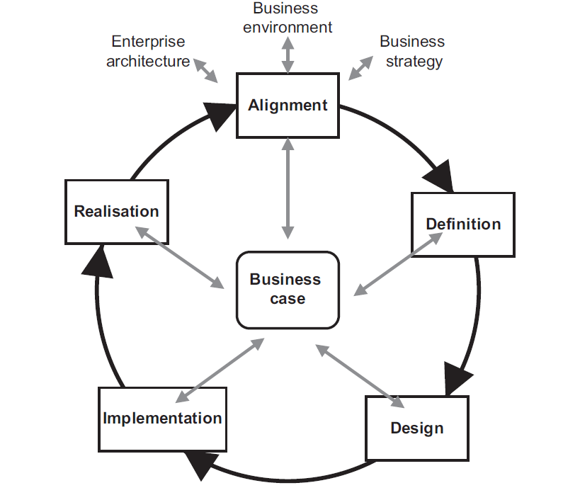
Business Change Lifecycle
Broader View of Business Change Programmes
Shift from IT projects to comprehensive business change initiatives
Recognition of essential roles and skill sets
Defined Roles in Business Change Lifecycle
Programme manager and change manager roles are well defined
Need for clear definition and recognition of business analyst role
Business Change Lifecycle Stages
Alignment and Definition stage focuses on organisational analysis
Change design and development, business acceptance testing, and benefits review
Importance of Business Analysis
Extensive analysis required for successful changes
Challenges in Business Change
Notes:
Organisations have shifted from IT projects to broader business change programmes, recognizing essential roles like programme and change managers. However, the business analyst role needs similar definition. The business change lifecycle involves stages like Alignment and Definition, change design, and benefits review. Extensive analysis is crucial for successful changes, yet many organisations lack a coherent approach involving business analysts, leading to unclear requirements and wasted investments. Original Content: Successful business change During the last few years, organisations have adopted a broader view – from IT projects to business change programmes. Within these programmes, there has been recognition of the need for roles and skill sets that enable the successful delivery of business change initiatives. The roles of the programme manager and change manager are well defined, with a clear statement of their scope and focus within the business change lifecycle. However, we now need to ensure that the business analyst role – one that uncovers the root causes of problems, identifies the issues to be addressed and ensures any solution will align with business needs – has a similar level of definition and recognition. Figure 1.1 shows a typical business change lifecycle. The early part of the business change lifecycle – Alignment and Definition – is concerned with the analysis of the organisation, its business needs and requirements in order to determine new ways of working that will improve the organisation’s efficiency and effectiveness. Later business change activities are concerned with change design and development, business acceptance testing and, post implementation, benefits review and realisation. Clearly, extensive analysis is required throughout the lifecycle if the changes are to be successful in order to deliver the desired benefits. The analysis work falls within the remit of business analysis yet, in many organisations, a coherent approach to business change, that includes business analysts in the business change lifecycle, is still awaited. As a result, it is often the case that the definition of the business needs and the requirements to ensure they are met are often unclear or not aligned. All too often the focus almost from the outset is on the solution rather than understanding what problem we are trying to address. The lack of clarity and alignment can result in the development or adoption of changes that fail to deliver business benefits and waste investment funds.

Slide 10
Role of Business Analysts in Change
Challenges in Delivering Predicted Business Benefits
Implementation of IT often fails to deliver promised benefits
Outsourcing of IT services adds complexity
Potential for Competitive Advantage
Information systems can yield competitive advantage
Often appears just out of reach
Need for New Skills
Support business managers in finding solutions
IT may not always be the answer
Development of Business Analyst Role
Global Economic Environment
Wise Use of Investment Funds
Notes:
The role of the business analyst has become crucial due to challenges in delivering predicted business benefits from IT implementations. Outsourcing adds complexity, and new skills are needed to support managers. Business analysts help achieve competitive advantage, especially in a global economic environment where wise use of investment funds is essential for survival. Original Content: The importance of the business analyst The delivery of predicted business benefits, promised from the implementation of IT, has proved to be extremely difficult, with the outsourcing of IT services serving to add complication to already complex situations. The potential exists for organisations to implement information systems that yield competitive advantage and yet this often appears to be just out of reach. Organisations also want help in finding potential solutions to business issues and opportunities, sometimes where IT may not prove to be the answer, but it has become apparent that this requires a new set of skills to support business managers in achieving this. These factors have led directly to the development of the business analyst role. Having identified the relevance of the business analyst role, we now need to recognise the potential this can offer, particularly in a global economic environment where budgets are limited and waste of financial resources unacceptable. The importance of using investment funds wisely and delivering the business benefits predicted for business change initiatives, has becoming increasingly necessary to the survival of organisations.

Slide 11
Internal vs External Consultants
Advantages of External Consultants
Provide expert advice on an 'as-needed basis'
Bring a broader business perspective
Offer a dispassionate, objective view
Criticisms of External Consultants
Lack of accountability
No transfer of skills to internal staff
High costs
Development of Internal Business Analysis Role
Internal analysts can provide similar services
Importance for IT-Enabled Business Change
Increasing Numbers of Internal Consultants
Notes:
Many organizations use external consultants for expert advice, but they face criticisms like high costs and lack of accountability. Internal business analysts can act as consultants, offering lower costs, speed, and retention of knowledge. This trend has grown, especially for IT-enabled business changes. Original Content: Business analysts as internal consultants Many organisations use external consultants to provide expert advice throughout the business change lifecycle. The reasons are clear – they can be employed to deal with a specific issue on an ‘as-needed basis’, they bring a broader business perspective and can provide a dispassionate, objective view of the company. On the other hand, the use of external consultants is often criticised, across all sectors, because of the lack of accountability and the absence of any transfer of skills from the external consultants to internal staff. Cost is also a key issue. Consultancy firms often charge daily fee rates that are considerably higher than the charge levied for an internal analyst and whilst the firms may provide consultants with a broad range of expertise steeped in best practice, this is not always guaranteed. The experiences gained from using external consultants have also played a part in the development of the internal business analysis role. Many business analysts have argued that they can provide the services offered by external consultants and can, in effect, operate as internal consultants. Reasons for using internal business analysts as consultants, apart from lower costs, include speed (internal consultants do not have to spend time learning about the organisation) and the retention of knowledge within the organisation. These factors have been recognised as particularly important for projects where the objectives concern the achievement of business benefit through the use of IT and where IT is a prime enabler of business change. As a result, while external consultants are used for many business purposes, the majority of business analysts are employed by their organisations. These analysts may lack an external viewpoint but they are knowledgeable about the business domain and crucially will have to live with the impact of the actions they recommend. Consequently, there have been increasing numbers of business analysts working as internal consultants over the last decade.

Slide 12

Defining the Role
Definition of Business Analyst Role
Major issue for business analysts
Role definition varies across forums
Range of Responsibilities
Business analysts capable of fulfilling various responsibilities
Roles do not always accurately represent capabilities
Notes:
The scope of business analysis work includes defining the role of business analysts. Discussions with numerous analysts reveal that their roles often do not reflect the full range of their responsibilities. Original Content: THE SCOPE OF BUSINESS ANALYSIS WORK A major issue for business analysts is the definition of the business analyst role. Discussions with several hundred business analysts, across a range of business forums, have established that business analysis roles do not always accurately represent the range of responsibilities that business analysts are capable of fulfilling.

Slide 13
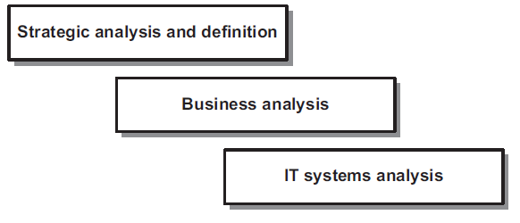
Range of Analysis Activities
Three main areas within the business analyst role
Strategic analysis
Business process redesign
Systems analysis
Overlap between areas
Consultants may engage in both strategic analysis and business process redesign
Systems analysts need to understand the overall business context
Importance of examining areas separately
Helps in understanding relevance to the business analyst role
Notes:
Business analysts work in three main areas: strategic analysis, business process redesign, and systems analysis. There is often overlap, such as consultants engaging in both strategic analysis and process redesign, and systems analysts understanding business context. Examining these areas separately helps understand their relevance. Original Content: The range of analysis activities One way in which we can consider the business analyst role is to examine the potential extent of analysis work. Figure 1.2 shows three areas that we might consider to be within the province of the business analyst. There are always unclear aspects where the three areas overlap. For example, consultants may specialise in strategic analysis but also get involved in business process redesign to make a reality of their strategies, and good systems analysts have always understood the need to understand the overall business context of the systems they are developing. However, it is useful to examine them separately in order to consider their relevance to the business analyst role Figure 1.2 The potential range of the business analyst role

Slide 14
Strategic Analysis and Definition
Strategic Analysis Responsibility
Primarily handled by senior management and strategy consultants
Business analysts may support but not lead this activity
Business Analysts' Access to Strategy
Should understand and support the execution of business strategy
Recommend and design tactics to achieve business objectives
Importance of Strategic Context
Vital for business analysts to work within strategic business context
Some roles may require strategic level thinking
Technology and Business Improvement
Business analysts advise on technology use for business change
Understanding Strategy Development
Notes:
Senior management and strategy consultants typically handle strategic analysis. Business analysts support this activity and must understand the business strategy to recommend tactics and IT solutions. They should work within the strategic context and advise on technology for business improvements. Chapter 3 explores strategic analysis techniques. Original Content: Strategic analysis and definition Strategic analysis and definition is typically the work of senior management, often supported by strategy consultants. Some business analysts may be required to undertake strategic analysis and identify business transformation actions, but it is more likely that they will have a role to play in supporting this activity. In the main, we believe that strategic analysis is mostly outside the remit of business analysis. We would, however, expect business analysts to have access to information about their organisation’s business strategy and be able to understand it, as their work will need to support the execution of this strategy. Business analysts often have to recommend and design the tactics that will deliver the business objectives and strategy, typically the process and IT system solutions. Hence, it is vital that they are able to work within the strategic business context. It may also be the case that some business analyst roles will require strategic level thinking. The use of IT to enable business improvements and the opportunities presented by technology will need to be considered during any strategy analysis and the business analysts are the specialist team that should be able to advise on the use of technology to drive business change. Given these issues, we feel that, while strategic analysis work is not core to business analysis, business analysts will need a good understanding of how strategy is developed and the impact upon the work of the IT and business change functions. In view of this, Chapter 3 explores a range of strategic analysis techniques and provides an overview of the strategic planning process.

Slide 15
IT Systems Analysis
Systems Analyst Role
Exists for over 40 years
Less commonly used term today
Responsibilities of Systems Analysts
Analyze and specify IT system requirements
Provide basis for software evaluation or bespoke development
Techniques Used in Systems Analysis
Data modeling
Focus of Systems Analysis
Organizational Approaches
Business Analyst vs. IT Business Analyst
Agile Approach
Notes:
Systems analysis has been a key IT discipline for over 40 years, focusing on analyzing and specifying IT system requirements. Techniques like data and process modeling are used to define software needs. Organizations may separate business and IT roles, with IT business analysts often performing systems analysis tasks. In Agile projects, business analysts collaborate closely with developers and users. Original Content: IT systems analysis At the other end of our model, there is the traditional IT discipline called systems analysis. The systems analyst role has been in existence for over 40 years although the term ‘systems analyst’ tends to be used less often these days. Systems analysts are responsible for analysing and specifying the IT system requirements in sufficient detail to provide a basis for the evaluation of software packages or the development of a bespoke IT system. Typically, systems analysis work involves the use of techniques such as data modelling and process or function modelling. This work is focused on describing the software requirements, and so the products of systems analysis define exactly what data the IT system will record, the processing that will be applied to that data and how the user interface will operate. Some organisations consider this work to be of such a technical nature that they perceive it to be completely outside the province of the business analyst. They have identified that modelling process and data requirements for the IT system is not part of the role of the business analyst and have separated the business analysis and IT teams into different departments, expecting the IT department to carry out the detailed IT systems modelling and specification. Other organisations differentiate between IT business analysts and ‘business’ business analysts, with those in IT often performing a role more akin to that of a systems analyst. In order to do this, the business analysts need a detailed understanding of IT systems and how they operate, and must be able to use the approaches and modelling techniques that fell historically within the remit of the system analyst role. The essential difference here is that a business analyst is responsible for considering a range of business options to address a particular problem or opportunity; on the other hand an IT business analyst, or systems analyst, works within a defined scope and considers options for the IT solution. In some organisations, there is little divide between the business analysts and the IT team. In these cases the business analysts work closely with the IT developers and include the definition of IT system requirements as a key part of their role. This is particularly the case where an Agile approach has been adopted for a software development project; the business analyst will work closely with the end users and development team to clarify the detailed requirements as they evolve during the development process.

Slide 16
Business Analysis
Investigating Business Systems
Improvements can vary considerably
Localised business issues or broader studies
Resolving Localised Business Issues
Recommend actions to overcome problems
Achieve business benefits
Broad Studies for Increased Efficiency
Extensive and detailed analysis
Enhancing or Replacing IT Systems
Cross-Functional Value Delivery
Understanding Business Situations
Techniques Required
Notes:
Business analysts investigate systems to recommend improvements. They resolve local issues or conduct broader studies for efficiency. They may enhance IT systems or work cross-functionally. Analysts clarify problems and consider all aspects for successful changes, using techniques like stakeholder analysis and process modelling. Original Content: Business analysis If the two analysis disciplines described above define the limits of analysis work, the gap in the middle is straddled by business analysis. This is reflected in Figure 1.2 which highlights the potential scope and extent of business analysis work. Business analysts will usually be required to investigate a business system where improvements are required but the range and focus of those improvements can vary considerably. It may be that the analysts are asked to resolve a localised business issue. In such a case, they would need to recommend actions that would overcome a problem or achieve business benefits. Perhaps it is more likely that the study is broader than this and requires investigation into several issues, or perhaps ideas, regarding increased efficiency or effectiveness. This work would necessitate extensive and detailed analysis of the business area. The analysts would need to make recommendations for business changes and these would need to be supported by a rigorous business case. Another possibility is that the business analyst is asked to focus specifically on enhancing or replacing an existing IT system in line with business requirements. In this case the analyst would deliver a requirements document defining what the business requires the IT system to provide. This document may define the requirements in detail or may be at a more overview level, depending upon the approach to the system development. Where an Agile approach is to be used, the business analyst may also be involved in prioritising the requirements and identifying those to be input into the next development iteration. More senior business analysts may be involved in working cross-functionally, taking a value delivery approach. This work is likely to require analysis of a workstream comprising various activities and systems. In this case, the analyst will need to have wide-ranging skills not only in analysis but also in stakeholder relationship management, and they will also require extensive business domain knowledge. Whichever situation applies, the study usually begins with the analyst gaining an understanding of the business situation in hand. A problem may have been defined in very specific terms, and a possible solution identified, but in practice it is rare that this turns out to be the entire problem and it is even less the case that any proposed solution addresses all of the issues. More commonly, there is a more general set of problems that require a broad focus and in-depth investigation. Sometimes, the first step is to clarify the problem to be solved as, without this, any analysis could be examining the wrong area and, as a result, identifying unhelpful solutions. For any changes to succeed the business analyst needs to consider all aspects, for example, what processes, IT systems, job roles, skills and other resources will be needed to improve the situation. In such situations, techniques such as stakeholder analysis, business process modelling and requirements engineering may all be required in order to identify the actions required to improve the business system. These three topics are the subject of later chapters in this book.

Slide 17
Business Case Development
Analysing Business Situations
Identify areas for business improvement
Develop a business case to justify investment
Consider risks involved
Quantification of Business Benefits
Ensure rigorous business case for expenditure
Focus on management and realisation of benefits
Financial Pressures on Organisations
Limited funds for investment
Need for wise spending
Calls for transparency
Role of Business Analyst
Notes:
Business analysts play a crucial role in identifying areas for improvement and developing business cases to justify investments. They ensure rigorous business cases and focus on the management and realisation of benefits. Financial pressures demand wise spending and transparency. Analysts assess impacts and support the evaluation of realised benefits. Original Content: Realising business benefits Analysing business situations, and identifying areas for business improvement, is only part of the process; the analyst may also be required to help develop a business case in order to justify the required level of investment and ensure any risks are considered. One of the key elements of the business case will be the identification and, where relevant, the quantification of the business benefits. Organisations are placing increasing emphasis upon ensuring that there is a rigorous business case to justify the expenditure on business improvement projects. However, defining the business case is only part of the picture – the focus on the management and realisation of these business benefits, once the solution has been delivered, is also growing. This is largely because organisations have limited funds for investment and need to ensure that they are spent wisely. There has been a long history of failure to assess whether or not business benefits have been realised from change projects but this is becoming increasingly unacceptable as the financial pressures mount on organisations and the calls for transparency grow. The business analyst will not be the only role involved in this work. However, ensuring that changes are assessed in terms of the impact upon the business case and, at a later point, supporting the assessment of whether or not predicted business benefits have been realised, is a key element of the role.

Slide 18
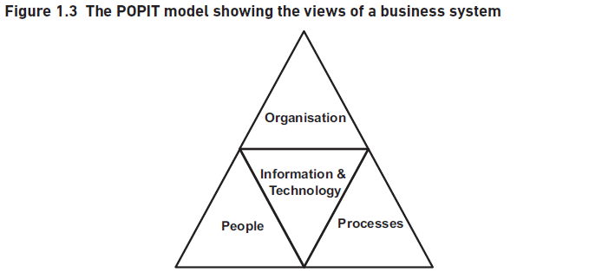
Holistic Approach
Importance of Holistic Approach
Business analysis requires considering the entire business system
All aspects need to be analyzed for uncovering improvement opportunities
POPIT Model
Different views to consider for business improvement
Processes, people, organization, information, and technology
Processes
People
Organization
Information
Technology
Focus on Business Improvement
Notes:
Business analysis requires a holistic approach, considering the entire business system. The POPIT model highlights processes, people, organization, information, and technology. Each area must be analyzed for improvement opportunities. Focus on business improvement, not just automation, ensures real benefits and prudent investments. Original Content: Taking a holistic approach There appears to be universal agreement that business analysis requires the application of a holistic approach. Although the business analyst performs a key role in supporting management’s exploitation of IT to obtain business benefit, this has to be within the context of the entire business system. Hence, all aspects of the operational business system need to be analysed if all of the opportunities for business improvement are to be uncovered. The POPIT model in Figure 1.3 shows the different views that must be considered when identifying areas for improving the business system This model shows us the different aspects, and the correspondences between them, that business analysts need to consider when analysing a business system. For each area, we might consider the following: The processes – are they well defined and communicated? Is there good IT support or are there several ‘work-arounds’ in existence? Does the process require documents to be passed around the organisation unnecessarily? Is there the potential for delays or the introduction of errors? The people – do they have the required skills for the job? How motivated are they? Do they understand the business objectives that they need to support? The organisation – is there a supportive management style? Are jobs and responsibilities well defined? Is there collaborative cross-functional working? The information – do the staff have the information to conduct their work effectively? Are managers able to make decisions based on accurate and timely information? The technology – do the systems support the business as required? Do they provide the information needed to run the organisation? We need to examine and understand all of these areas to uncover where problems lie and what improvements might be possible, if the business system is to become more effective. Taking a holistic view is vital as this ensures not only that all of the aspects are considered but also the linkages between them. It is often the case that the focus of a business analysis or business change study is primarily on the processes and the IT support. However, even if we have the most efficient processes with high standards of IT support, problems will persist if issues with staffing, such as skills shortages, or the organisation, such as management style, have not also been addressed. It is vital that the business analyst is aware of the broader aspects relating to business situations such as the culture of the organisation and its impact on the people and the working practices. The adoption of a holistic approach will help ensure that these aspects are included in the analysis of the situation. Business analysis places an emphasis on improving the operation of the entire business system. This means that, while technology is viewed as a factor that could enable improvements to the business operations, other possibilities are also considered. The focus should be on business improvement, rather than on the use of automation per se, resulting in recommendations that improve the business. Typically, these include the use of IT but this is not necessarily the case. There may be situations where a short-term non-IT solution is both helpful and cost-effective. For example, a problem may be overcome by developing internal standards or training members of staff. These solutions may be superseded by longer term, possibly more costly, solutions, but the focus on the business has ensured that the immediate needs have been met. Once urgent issues have been addressed, the longer term solutions can be considered more thoroughly. It is important that our focus as business analysts is on identifying opportunities for improvement with regard to the needs of the particular situation. If we do this, we can recommend changes that will help deliver real business improvements and ensure that funds are invested prudently.

Slide 19

Agile Philosophy
Emergence of Agile
Developed in the late 1990s
Reaction to linear waterfall lifecycle
Agile Philosophy
Deliver software increments early
Elaborate requirements using prototyping
Agile Manifesto Values
Individuals and interactions over processes and tools
Working software over comprehensive documentation
Customer collaboration over contract negotiation
Responding to change over following a plan
Notes:
Agile systems development emerged in the late 1990s as a reaction to the linear waterfall lifecycle. The Agile philosophy focuses on delivering software increments early and elaborating requirements through prototyping. The Agile Manifesto values individuals and interactions, working software, customer collaboration, and responding to change. Original Content: Agile systems development Agile is a software development approach which emerged in the late 1990s in the wake of approaches such as Rapid Application Development (RAD) and the Dynamic System Development Method (DSDM). The use of such approaches evolved as a reaction to the linear waterfall lifecycle, with its emphasis on completing a stage before moving on to the next stage. The Agile philosophy is to deliver software increments early and to elaborate requirements using approaches such as prototyping. The Agile Manifesto stated: We are uncovering better ways of developing software by doing it and helping others do it. Through this work we have come to value: Individuals and interactions over processes and tools Working software over comprehensive documentation Customer collaboration over contract negotiation Responding to change over following a plan That is, while there is value in the items on the right, we value the items on the left more.

Slide 20
Role of Business Analysts in Agile
Supporting Business Users
Clarifying requirements
Elaborating requirements
Prioritising requirements
Early Business Analysis Work
Uncovering problems
Defining business requirements
Timeboxed Iterations
Collaborative teams
Developing part of the software
Domain Expertise and Analytical Ability
Assessing impact of proposed functionality
Notes:
In Agile projects, business analysts support users by clarifying, elaborating, and prioritizing requirements. Early analysis uncovers problems and defines requirements. During timeboxed iterations, collaborative teams develop software parts. Analysts bring domain expertise and assess functionality impact within the strategic business context. Original Content: So, what does this mean for the business analyst? In essence, where a business analyst is working on a project where an Agile software development approach has been adopted, the analyst will be involved in supporting the business users in clarifying, elaborating and prioritising the requirements during the development process. While some early business analysis work will have been required to uncover the problems to be addressed and define the business requirements, at a solution level the more detailed requirements will be elaborated during timeboxed iterations where collaborative teams comprising users, analysts and developers work together to develop part of the software required product. The business analyst brings domain expertise and analytical ability to the development team, assisting the users by assessing the impact of proposed functionality in the light of the strategic business context. The role of the business analyst in an Agile environment is explored further in Chapters 10 and 13

Slide 21

Supporting Business Change
Business Acceptance Testing
Developing test scenarios
Working with business users on new processes and systems
Implementation Support
Writing procedure manuals and user guides
Training business staff on new processes and IT systems
Defining job roles and writing descriptions
Providing ongoing support for new approaches
Notes:
Business analysts play a crucial role in supporting business change. They help with business acceptance testing, implementation support, and training staff on new processes and systems. Their involvement ensures smooth transitions and adoption of new approaches. Original Content: Supporting business change It is often commented that, even when the business analysts have defined excellent solutions that have been well-designed and developed, business improvement initiatives can fail during implementation. The business analyst may be required to support the implementation of the business changes. Figure 1.3 also offers an effective structure for identifying the range of areas to be considered. One aspect may concern the business acceptance testing – a vital element if business changes are to be implemented smoothly. The business analyst’s involvement in business acceptance testing can include work such as developing test scenarios and working with the business users as they apply the scenarios to their new processes and systems. Further, the implementation of business change may require extensive support from the business analysts, including tasks such as: writing procedure manuals and user guides; training business staff in the use of the new processes and IT systems; defining job roles and writing job role descriptions; providing ongoing support as the business staff begin to adopt the new, unfamiliar, approaches The role of the business analyst throughout the change lifecycle is explored further in Chapter 14.

Slide 22
Core Responsibilities
Investigate Business Systems
Take a holistic view of the situation
Examine organisational structures and staff development issues
Review current processes and IT systems
Evaluate Actions for Improvement
Examine organisational structure
Assess staff development needs
Ensure alignment with proposed process redesign and IT system development
Document Business Requirements
Use appropriate documentation standards
Support Business Users
Advisory Role
Notes:
A business analyst investigates and evaluates business systems, examines organizational structures, and reviews processes and IT systems. They document requirements, support users during system development, and advise on improving business systems. Their role ensures effective implementation and use of information systems. Original Content: THE ROLE AND RESPONSIBILITIES OF A BUSINESS ANALYST So where does this leave us in defining the role and responsibilities of a business analyst? Although there are different role definitions, depending upon the organisation, there does seem to be an area of common ground where most business analysts work. These core responsibilities are: Investigate business systems taking a holistic view of the situation; this may include examining elements of the organisation structures and staff development issues as well as current processes and IT systems. Evaluate actions to improve the operation of a business system. Again, this may require an examination of organisational structure and staff development needs, to ensure that they are in line with any proposed process redesign and IT system development. Document the business requirements for the IT system support using appropriate documentation standards. Elaborate requirements, in support of the business users, during evolutionary system development. In line with this, we believe the core business analyst role should be defined as: An advisory role which has the responsibility for investigating and analysing business situations, identifying and evaluating options for improving business systems, elaborating and defining requirements, and ensuring the effective implementation and use of information systems in line with the needs of the business.

Slide 23
Extended Responsibilities
Strategy Implementation
Work closely with senior management
Define effective business systems
Business Case Production
Handled by senior business analysts
Assistance from Finance specialists
Benefits Realisation
Post-implementation reviews
Evaluate achieved benefits
Identify actions to achieve benefits
Specification of IT Requirements
Rationale for Business Analysis
Notes:
Business analysts have expanded roles including strategy implementation, business case production, benefits realisation, and IT requirements specification. They work closely with senior management, conduct post-implementation reviews, and use standard modelling techniques. Their role is crucial in today's business world, imposing significant responsibilities. Original Content: Some business analysis roles extend into other areas, possibly the strategic analysis or systems analysis activities described above. This may be where business analysts are in a more senior role or choose to specialise. These areas are: Strategy implementation – here the business analysts work closely with senior management to help define the most effective business system to implement elements of the business strategy. Business case production – more senior business analysts usually do this, typically with assistance from Finance specialists. Benefits realisation – the business analysts carry out post-implementation reviews, examine the benefits defined in the business case and evaluate whether or not the benefits have been achieved. Actions to achieve the business benefits are also identified and sometimes carried out by the business analysts. Specification of IT requirements – typically using standard modelling techniques such as data modelling or use case modelling. The definition of the business analyst role may be expanded by considering the rationale for business analysis. The rationale seeks to explain why business analysis is so important for organisations in today’s business world and imposes responsibilities that business analysts must recognise and accept.

Slide 24
Rationale for Business Analysis
Challenge Pre-determined Solutions
Identify and evaluate options for meeting business needs
Feasible, contributing requirements not meeting all requests
Consider Financial and Timescale Constraints
Identify requirements that are not feasible and do not contribute to business objectives
Evaluate stated requirements against business needs and constraints
Support Business Change Lifecycle
Analyse business situations
Support development, testing, deployment and post-implementation review of solutions
Negotiate Conflicting Stakeholder Views
Distinguish Root Causes from Symptoms
Enable Business Improvement and Agility
Notes:
Business analysis involves challenging pre-determined solutions, considering financial constraints, supporting the business change lifecycle, negotiating conflicting stakeholder views, distinguishing root causes from symptoms, and enabling business improvement and agility. Original Content: To challenge pre-determined solutions To identify and evaluate options for meeting business needs Feasible, contributing requirements not meeting all requests To be aware of financial and timescale constraints To identify requirements that are not feasible and do not contribute to business objectives To evaluate stated requirements against business needs and constraints The entire business change lifecycle not just requirements definition To analyse business situations To support the effective development, testing, deployment and post-implementation review of solutions To support the management and realisation of business benefits Negotiation not avoidance To recognise conflicting stakeholder views and requirements To negotiate conflicts between stakeholders The rationale for business analysis is: Root causes not symptoms To distinguish between the symptoms of problems and the root causes To investigate and address the root causes of business problems To consider the holistic view Business improvement not IT change To recognise that IT systems should enable business opportunity or problem resolution To analyse opportunities for business improvement To enable business agility Options not solutions

Slide 25
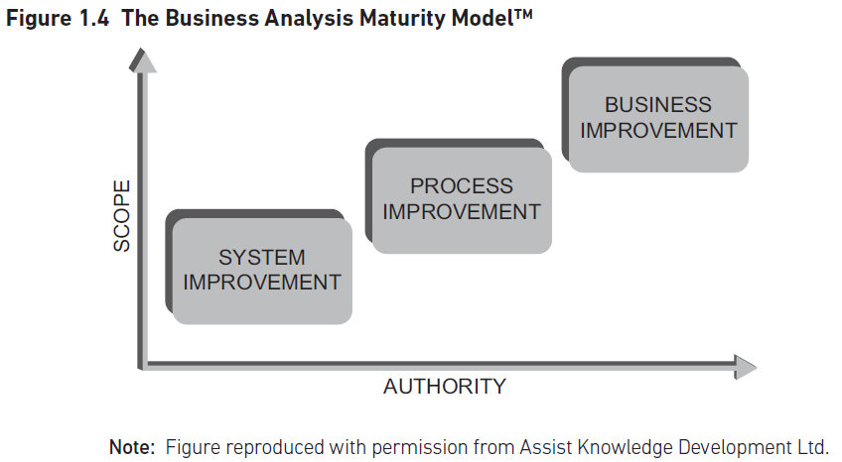
Development and Maturity
Development of Business Analysis Practice
Reflects progression within organizations
Developed by Assist Knowledge Development Ltd
Scope and Authority of Business Analysts
Scope can be specific or ambiguous
Authority varies from limited to senior management influence
Three Levels of Maturity
Level 1: Defining IT system requirements
Level 2: Cross-functional business process improvement
Level 3: Supporting senior management to deliver value
Notes:
The Business Analysis Maturity Model reflects the development of business analysis within organizations. It considers the scope and authority of business analysts, which can vary significantly. The model outlines three levels of maturity: defining IT system requirements, cross-functional business process improvement, and supporting senior management to deliver value. Original Content: THE BUSINESS ANALYSIS MATURITY MODEL As the Business Analysis Practice has developed within organisations, a progression for business analysis itself has emerged reflecting this development. The Business Analysis Maturity ModelTM (BAMM) shown in Figure 1.4 was developed by Assist Knowledge Development Ltd to represent the development and maturity of business analysis. This model reflects discussions with several hundred, if not thousands, of business analysts working for numerous organisations across the UK, Europe and beyond. These business analysts have come from different backgrounds – some from IT, many from business areas – and have brought different skills and knowledge to their business analysis teams. The BAMM uses two axes: the scope of the work allocated to the business analyst and the authority level of the business analyst. The scope may be very specific if an initial study has identified the required course of action and the analyst now needs to explore and define solution in greater detail. Alternatively, the scope may have been defined at only an overview level, or may be very ambiguous, with the business analyst having to carry out detailed investigation to uncover the issues before the options can be explored. The level of authority of the business analyst can also vary considerably, from a limited level of authority to the ability to influence and guide at senior management level. The BAMM shows three levels of maturity during the development of business analysis. The first level is where the business analysis work is concerned with defining the requirements for an IT system improvement. At this level, the scope is likely to be well-defined and the level of authority limited to the project on which the business analyst works. The next level is where the business analysis work has moved beyond a specific IT development so that the analysts work cross-functionally to improve the business processes that give rise to the requirements. The third level is where the scope and authority of the analysts are at their greatest. Here, the business analysis work is concerned with improving the business and working with senior management to support the delivery of value to customers.

Slide 26
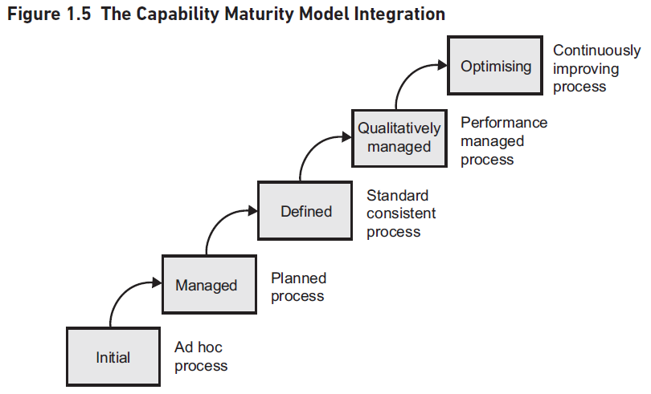
Comparison with CMMI
Three Perspectives on Business Analysis
Individual analysts
Business analysis community within an organisation
Business analysis profession as a whole
Application of Techniques and Skills
Use of standards
Evaluation through measures
Link to Capability Maturity Model Integration (CMMI)
Developed by Software Engineering Institute (SEI)
Used for process improvement
Levels of CMMI Applied to BAMM
Business Analysis Practice Maturity Assessment
Notes:
Business analysis maturity levels apply to individual analysts, the community within an organisation, and the profession as a whole. Techniques, standards, and evaluations vary. The BAMM links to CMMI, developed by SEI for process improvement. CMMI levels apply to BAMM, from Systems Improvement to Managed. A specific CMMI version assesses Business Analysis Practice maturity. Original Content: These levels of maturity apply to three perspectives on business analysis: the individual analysts, the business analysis community within an organisation, and the business analysis profession as a whole. At each level, the application of techniques and skills, the use of standards, and the evaluation of the work through measures, can vary considerably. One of the points often raised about the BAMM is the link to the Capability Maturity Model Integration (CMMI) represented in Figure 1.5. The CMMI was developed by the Software Engineering Institute (SEI) at Carnegie Mellon University and is an approach used for process improvement in organisations. If we consider the BAMM in the light of the CMMI, we can see that the five levels of the CMMI apply at each level. An organisation that is developing its Business Analysis Practice may employ business analysts who are chiefly employed on requirements definition work. In doing this, the analysts may initially have to develop their own process and standards for each piece of work. Therefore, they would be at the Systems Improvement level of the BAMM and the Initial level of the CMMI. By contrast, an organisation that has employed business analysts for some time may have analysts that can work at all three levels of the BAMM. The analysts working at the Business Improvement level may have a defined process, standards and measures that are managed for each assignment. These business analysts are working at the Managed level of the CMMI. It is also useful to consider a version of CMMI, specifically developed to evaluate the maturity of the Business Analysis Practice. Figure 1.6 shows a possible approach to this maturity assessment.

Slide 27
Qualifications and Standards
Qualifications
Determine the standard of skills and abilities
Recognised by employing organisations
Common qualifications: BCS International Diploma, IIBA® CBAP® or CCBA® certifications
Expert BA Award for senior business analysts
Organisations increasingly require qualifications
Standards
Techniques and documentation standards
Templates for documents
Standardised modelling techniques like Unified Modeling Language
Continuing Professional Development
Professional Body
Notes:
Business analysis has evolved into a profession over the past 25 years. Key factors include qualifications, standards, continuing professional development, and professional bodies. Qualifications like BCS and IIBA certifications are essential. Standards involve techniques and documentation. Continuous development is crucial for maintaining professional status. Professional bodies define standards and conduct. Original Content: PROFESSIONALISM AND BUSINESS ANALYSIS Business analysis has developed a great deal over the last 25 years, to the extent that it is often referred to as a ‘profession’ and many practitioners view themselves as having a career in business analysis. The factors that support professionalism in business analysis are as follows: Qualifications – qualifications that determine the standard of skills and abilities of the individual professional that are recognised by employing organisations. Many business analysts hold qualifications such as the BCS International Diploma in Business Analysis or the IIBA® CBAP® or CCBA® certifications. The seniority of some business analysts has also been recognised by the introduction of the Expert BA Award offered by the BA Manager Forum. It is increasingly the case that organisations require business analysts to hold qualifications. Standards – techniques and documentation standards that are applied in order to carry out the work of the profession. Organisations typically have templates for documents and standardise on modelling techniques such as those provided by the Unified Modeling Language. Books such as this one are also used in many organisations as a foundation for standards of business analysis practice. Continuing Professional Development – recognition of the need for the continuing development of skills and knowledge in order to retain the professional status. Professional Body – a body with responsibility for defining technical standards and the code of conduct, promoting the profession and carrying out remedial action where necessary. This may require the removal of members where they do not reach the standard required by the code of conduct. The major professional bodies for business analysts are BCS, the Chartered Institute for IT and IIBA.

Slide 28
Future of Business Analysis
Significance of Business Analysis
Ensures delivery of business benefits
Prevents unwise investments
Effective Deployment of Technology
Supports organizational work
Identifies relevant options for business change
Objective Views and Problem Solving
Challenges conventional wisdom
Uncovers root causes of problems
Skills and Development
Guidance on Business Change
Outsourcing Initiatives
Notes:
Business analysis is crucial for delivering business benefits and preventing poor investments. It ensures effective technology deployment and identifies options for business change. Analysts challenge conventional wisdom, uncover root causes, and define beneficial changes. They develop skills, bridge IT and business, and guide business change. Their role is vital in outsourcing initiatives to deliver customer value. Original Content: THE FUTURE OF BUSINESS ANALYSIS Business analysis has developed into a specialist discipline that can offer significant value to organisations, not least by assuring the delivery of business benefits and preventing unwise investments in ill-conceived solutions. Business analysis offers an opportunity for organisations to ensure not only that technology is deployed effectively to support the work of the organisation, but also that relevant options for business change are identified that take account of budgetary and timescale pressures. Business analysts can offer objective views that can challenge conventional wisdom, uncover root causes of problems and define the changes that will accrue real business benefits. Business analysts are passionate about their work and the contribution they can make. They continually develop their skills and extend the breadth of work they can undertake. Not only are they able to bridge IT and ‘the business’ but they can also offer guidance on how to approach business change work and where priorities might lie. Where outsourcing initiatives operate across departmental boundaries and sometimes have impacts upon the entire organisation, the work carried out by business analysts is vital if the new part in-house, part outsourced processes and technology are going to deliver value to customers. The challenge for the analysts is to ensure that they develop the extensive toolkit of skills, behavioural, business and technical, that will enable them to engage with the problems and issues facing their organisations, and assist in their resolution. The challenge for the organisations is to support the analysts in their personal development, recognise the important contribution they offer, ensure they have the authority to carry out business analysis to the extent required by the situations they face, and listen to their advice. This book has been developed primarily for the business analysis community but it is also intended to help business professionals face the challenges of today’s business environment; we hope anyone involved in defining and delivering business change will find it useful.

